Slide 1
Setting and Keeping Professional Learning Goals
Core Advocates Monthly Webinar
October 3, 2018

Slide 2
Introductions
Your hosts from the Professional Learning Team
Jennie Beltramini, Math Specialist
Tori Filler, Literacy Specialist
Nicole Bravo, Project Manager
This Month’s Guests -
Lisa Goldschmidt, EVP Tools and Classroom Resources
Adrianne Sublett, Literacy Instructional Curriculum Coach

Slide 3
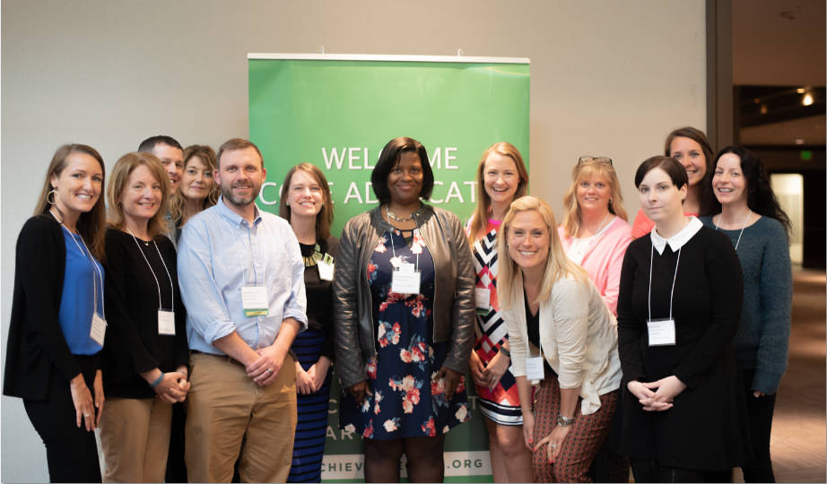
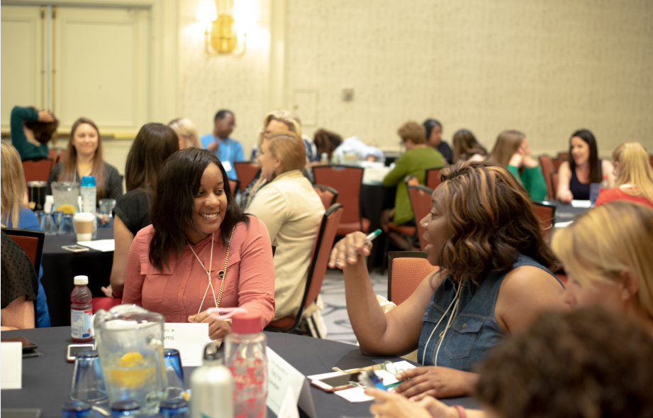
Who Are Core Advocates?
Core Advocates believe in the power of standards to prepare all students for college and/or careers.
They are eager to support and collaborate with their colleagues and communities in understanding and translating the Shifts into instructional practice.
Core Advocates have the tools and knowledge to advocate for high-quality instruction, instructional resources, and professional learning in their communities.

Slide 4

Learn More About Us!
Contact Jennie Beltramini (jbeltramini@studentsachieve.net )
Complete this survey to join our database (and mailing list): www.achievethecore.org/ca-signup
Visit our website: www.achievethecore.org

Slide 5

Tweet with Us!
Please feel free to tweet during and after the webinar using #coreadvocates
@achievethecore
@JennieBeltro
@mrs_sublett

Slide 6
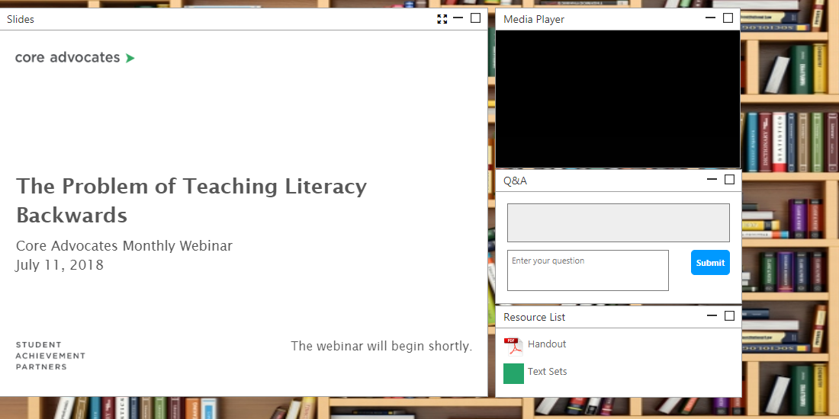
Engage with Us!
During the webinar
– Questions option
– Find the handouts and
resources
After the webinar
– Access to recorded
webinar

Slide 7

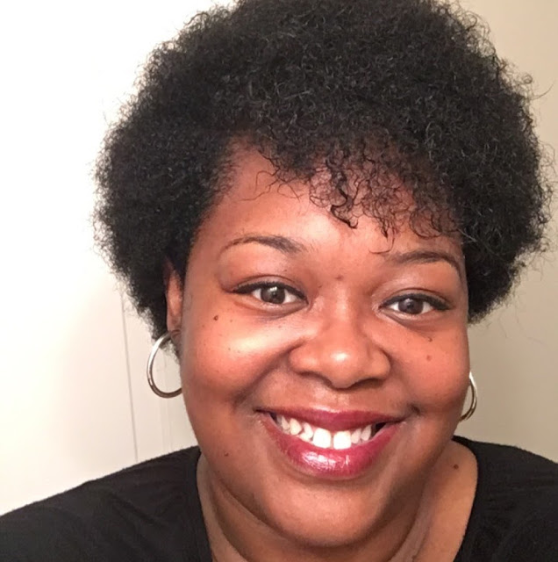
Lisa Goldschmidt
Executive Vice President of Tools and Classroom Resources
Student Achievement Partners
Adrianne Sublett
Literacy Instructional Curriculum Coach
Memphis, TN

Slide 8
Goals of the Webinar
Explore strategies for developing focused professional goals as an educator.
Learn about the Instructional Practice Guide (IPG) - what it is and what has changed.
Find tools to help you plan for aligned instruction and continue to make progress toward your goals over the course of a school year.
Understand how the IPG supports setting and keeping professional learning goals.

Slide 9
Section 1: What are some strategies educators use to set goals for themselves?

Slide 10

Why set (and work toward) specific goals?
Naming specific goals helps focus our efforts.
The process of goal setting forces us to reflect on what matters most to us as educators.
Developing goals with a specific action plan for achieving them keeps us on track and helps us celebrate progress!
Most importantly, goals make it possible for us to see the intersections between what we do as teachers and what our students can achieve.
Notes:
Educators are no strangers to goals! Educators have a lot of goals set for them: instructional standards, school goals, district goals. But it’s really important that educators have a chance to set their own goals focused on their own professional ambitions and their own student needs in order to be able to engage in grade-level, standards-aligned work.
The beginning of the school year is such a busy time, and it can seem daunting to find the time to sit down and develop both goals and an action plan--but taking that time early on pays off for the rest of the year. Today, we’ll be talking about an approach for setting focused, actionable goals that you can help you be successful. We believe that developing these goals now is valuable because…
Naming specific goals helps focus our efforts
The process of goal setting forces us to reflect on what matters most to us as educators
Developing goals with a specific action plan for achieving them keeps us on track and helps us celebrate progress!

Slide 11
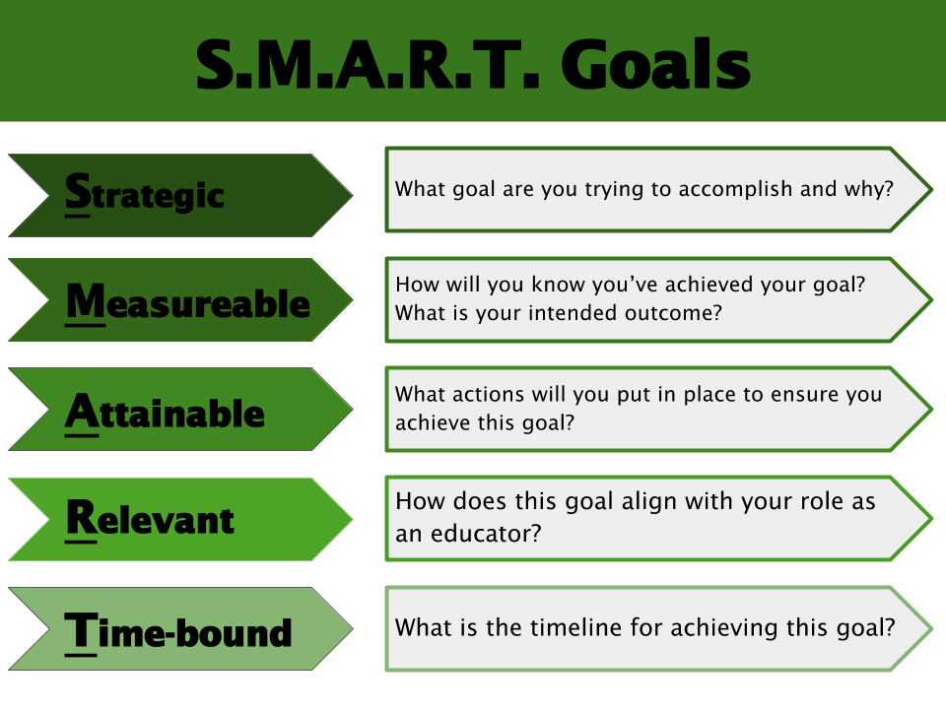
SMART Goals for Educators
Setting S.M.A.R.T. Goals as an Educator https://achievethecore.org/aligned/setting-s-m-a-r-t-goals-as-an-educator/
Notes:
My colleague Susan Hitt has a great blog post on Aligned about the elements of SMART goals for educators. You can access it in your Resource tab. The elements of the SMART goal model really help ensure that you are setting yourself up for success with your goal--and that the goal you set is connected in a meaningful way to the impact you have on students.

Slide 12

Take a minute to reflect...
What is one goal you’d like to work toward this year? Keep it in mind as we begin to introduce some resources and consider how the resources might fit into your plan.

Slide 13
Section 2: What is the Instructional Practice Guide?

Slide 14
Question: How familiar are you with the Instructional Practice Guide
Not at all
A little bit
Fairly familiar
Very familiar

Slide 15
Purpose of the Instructional Practice Guide
“The Instructional Practice Guide (IPG) is a K–12 classroom observation rubric that prioritizes what is observable in and expected of classroom instruction when instructional content is aligned to college- and career-ready (CCR) standards, including the Common Core State Standards (CCSS). It purposefully focuses on the limited number of classroom practices tied most closely to content of the lesson. Designed as a developmental rather than an evaluation tool, the IPG supports planning, reflection, and collaboration, in addition to coaching.”
www.achievethecore.org/instructional-practice
Notes:
One of the tools you saw mentioned frequently in the model SMART goal was the Instructional Practice Guide. This tool can help you at a variety of points as you set, work toward, and evaluate your progress with you goal. So what is it?
Why was the IPG created? What is it intended to do?

Slide 16
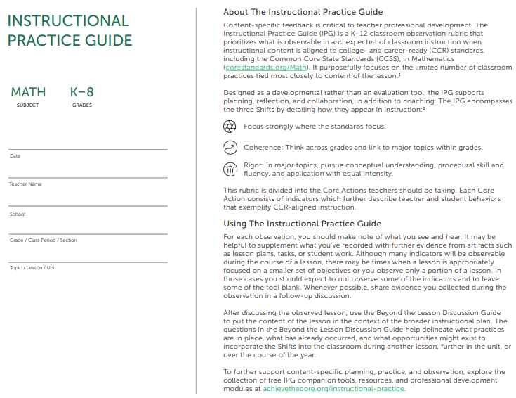
Design of the Instructional Practice Guide
Grounded in research
Intentionally limited number of “look-fors”
Content-focused
Grade- and subject-specific
Notes:
Research
Number of indicators
Focus on content

Slide 17
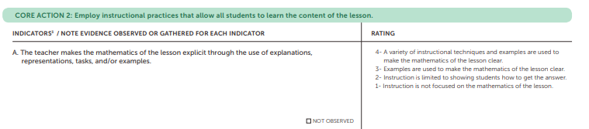
Structure of the Instructional Practice Guide
Core Action 1: Content of the lesson
Core Action 2: Instruction
Core Action 3: Students
Notes:
Core Actions (Core Action 1 - specific to content, Core Action 2 - specific to instruction, Core Action 3 - students)
Indicators
Evidence
Ratings

Slide 18
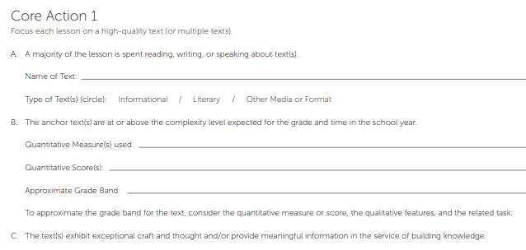
IPG and SMART Goals
Planning and observation tied to critical components of the lesson content
Quantitative and qualitative text analysis for anchor texts
Knowledge and vocabulary building
Notes:
The Core Actions help you focus on critical elements of a lesson. The language of Core Action 1 is really focused on what’s being taught; the Indicators tie to potential interim goals and observable components (such as using the text complexity analysis tools to pick grade-level complex texts).

Slide 19
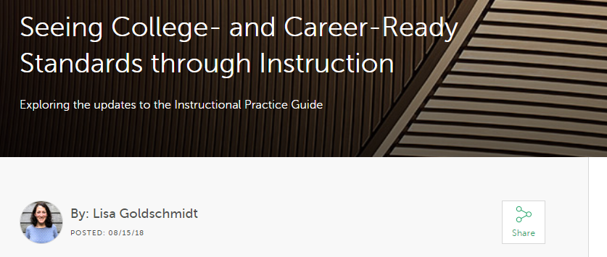
What has changed about the IPG?
(That’s me.)
https://achievethecore.org/aligned/ipg-updates/

Slide 20
What’s New: ELA/Literacy
Previous IPG | New IPG
1B. The text(s) are at or above the complexity level expected for the grade and time in the school year. | 1B. The anchor text(s) are at or above the complexity level expected for the grade and time in the school year. Quantitative Measure(s) used: Quantitative Score(s): Approximate Grade Band: To approximate the grade band for the text, consider the quantitative measure or score, the qualitative features, and the related task.
Yes- The text(s) are at or above both the qualitative and quantitative complexity expected for the grade and time in the school year. No- The text(s) are below both the qualitative and quantitative complexity expected for the grade and time in the school year. | Yes- The anchor text(s) are at or above both the qualitative and quantitative complexity expected for the grade and time in the school year. No- The anchor text(s) are below the qualitative and/or quantitative complexity expected for the grade and time in the school year. N/A- Anchor text not observed

Slide 21
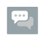
What’s New: ELA/Literacy
Previous IPG | New IPG
1B. The text(s) are at or above the complexity level expected for the grade and time in the school year. | 1B. The anchor text(s) are at or above the complexity level expected for the grade and time in the school year. Quantitative Measure(s) used: Quantitative Score(s): Approximate Grade Band: To approximate the grade band for the text, consider the quantitative measure or score, the qualitative features, and the related task.
Yes- The text(s) are at or above both the qualitative and quantitative complexity expected for the grade and time in the school year. No- The text(s) are below both the qualitative and quantitative complexity expected for the grade and time in the school year. | Yes- The anchor text(s) are at or above both the qualitative and quantitative complexity expected for the grade and time in the school year. No- The anchor text(s) are below the qualitative and/or quantitative complexity expected for the grade and time in the school year. N/A- Anchor text not observed
What do you notice?
Pause to type your answers in the Group Chat box.

Slide 22

What’s New: ELA/literacy
Greater emphasis on text purpose; anchor texts vs those used for knowledge building and independent reading
Language specifying qualitative text features
Increased clarity in Core Action 3 to remove overlapping ideas and respond to frequently asked questions
K-2 Foundational Skills

Slide 23
What’s New: Math
Previous IPG | New IPG
1A. The lesson focuses on the depth of grade-level cluster(s), grade-level content standard(s), or part(s) thereof. | 1A. The enacted lesson focuses on the grade-level cluster(s), grade-level content standard(s), or part(s) thereof. Mathematical learning goal: Standard(s) addressed in this lesson:
Yes - The lesson focuses only on mathematics within the grade-level standards and fully reflects the depth of the grade-level cluster(s), grade-level content standard(s), or part(s) thereof. No - The lesson focuses on mathematics outside the grade-level standards or superficially reflects the grade-level cluster(s), grade-level content standard(s), or part(s) thereof. | Yes- The enacted lesson focuses only on mathematics within the grade-level standards. No- The enacted lesson focuses on mathematics outside the grade- level standards.

Slide 24
What’s New: Math
Previous IPG | New IPG
1A. The lesson focuses on the grade-level cluster(s), grade-level content standard(s), or part(s) thereof. | 1A. The enacted lesson focuses on the grade-level cluster(s), grade-level content standard(s), or part(s) thereof. Mathematical learning goal: Standard(s) addressed in this lesson:
Yes - The lesson focuses only on mathematics within the grade-level standards and fully reflects the depth of the grade-level cluster(s), grade-level content standard(s), or part(s) thereof. No - The lesson focuses on mathematics outside the grade-level standards or superficially reflects the grade-level cluster(s), grade-level content standard(s), or part(s) thereof. | Yes- The enacted lesson focuses only on mathematics within the grade-level standards. No- The enacted lesson focuses on mathematics outside the grade- level standards.
What do you notice?
Pause to type your answers in the Group Chat box.

Slide 25
What’s New: Math
“Enacted lesson” vs “lesson”
Reference to mathematical errors
Clarifications in response to frequently asked questions; emphasis on purpose
Moved key concepts to Beyond the Lesson, where appropriate

Slide 26
Section 3: How can the IPG (and other tools) support planning for aligned instruction?

Slide 27
Planning for What’s Observed
Use consistent structures and protocols--everyone should be on the same page!
Agreeing upon those components with your coach/colleague (or just naming them for yourself) helps ensure you’ll be focused and successful.
Ahead of a coaching session, observation, or self-reflection, make sure your lesson plan includes the specific changes or improvements you’re working on as part of your goal.
Consider your goals in the context of a lesson, a unit, and over the year.

Slide 28
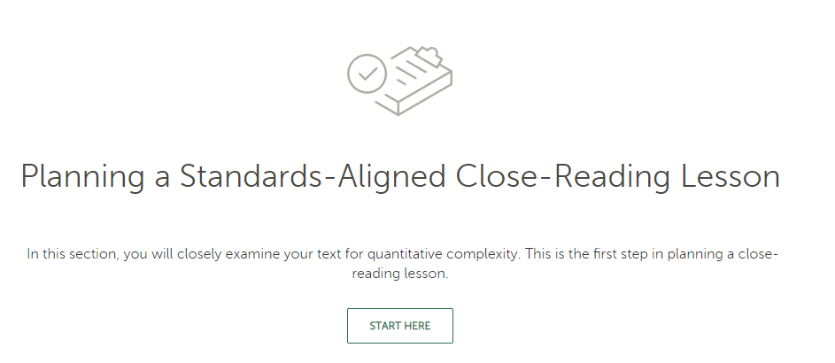

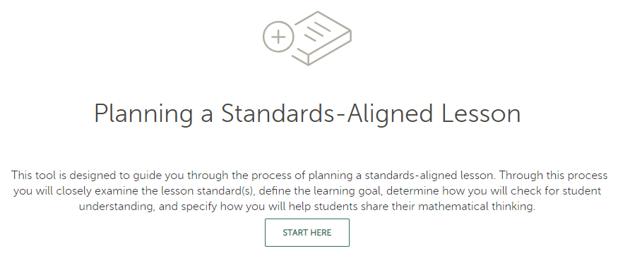
Lesson Planning Tool
https://achievethecore.org/lesson-planning-tool/
Notes:
LPT exists for math and ELA/literacy. For ELA, the focus is on developing a close-reading lesson.

Slide 29
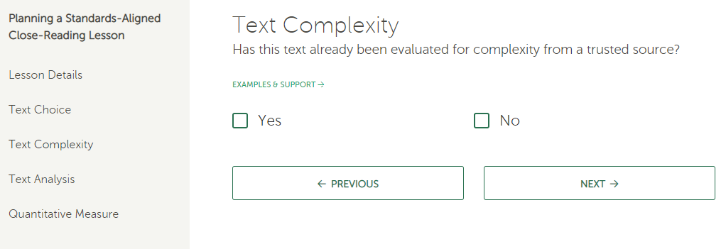
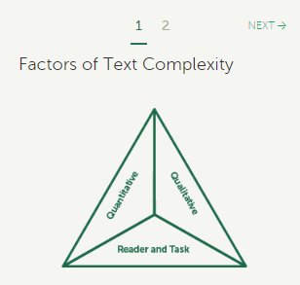
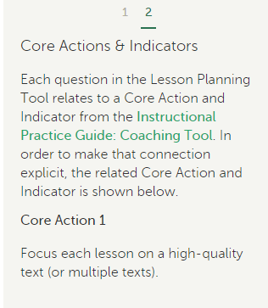
Using the Lesson Planning Tool with the IPG
Notes:
Tying planning to goals (in the examples, doing more text analysis) and being intentional about building it into observation.

Slide 30
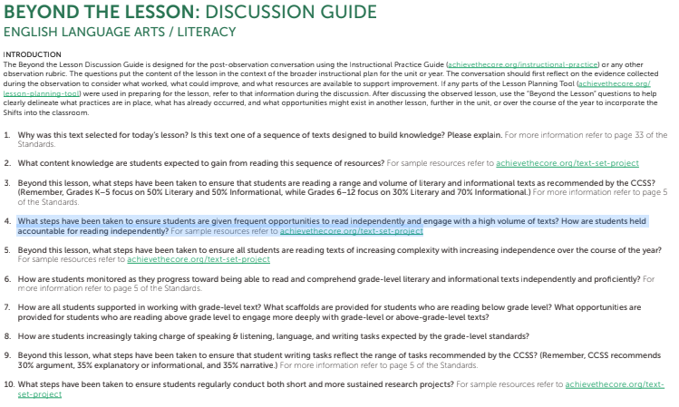
Beyond the Lesson Discussion Guides
Notes:
Oftentimes, your goal will be something you’re working on over the course of an entire school year. That means that you’ll want to integrate opportunities to revisit how your interim actions, and the actions being observed in a single lesson, relate to bigger goal.
A teacher and her coach or colleague might plan to discuss one of the Beyond the Lesson Guide questions to think about how that action contributes to her goals for her students.
The Beyond the Lesson Guide (available for Math and ELA) poses questions like these, and relate back to the Core Actions and Indicators.

Slide 31
Take a minute to reflect...
Think back to the goal you identified at the start of this webinar. How might the IPG and other resources discussed fit into your plan for meeting that goal?

Slide 32
Section 4: How have educators used the IPG to set and keep professional learning goals?

Slide 33
Adrianne Sublett
Literacy Instructional Curriculum Coach
Memphis, TN
Notes:
Janelle

Slide 34
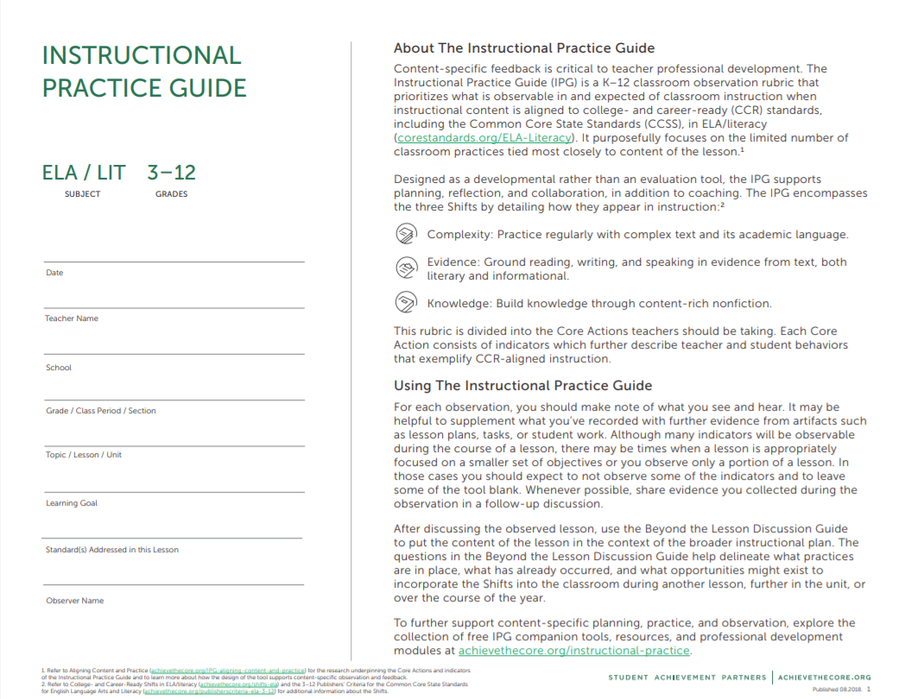
How We Used the IPG
Incorporating the IPG into existing initiatives/structures

Slide 35

How We Used the IPG
Setting goals
for individuals and/or groups

Slide 36

How We Used the IPG
Providing regular, formative feedback

Slide 37
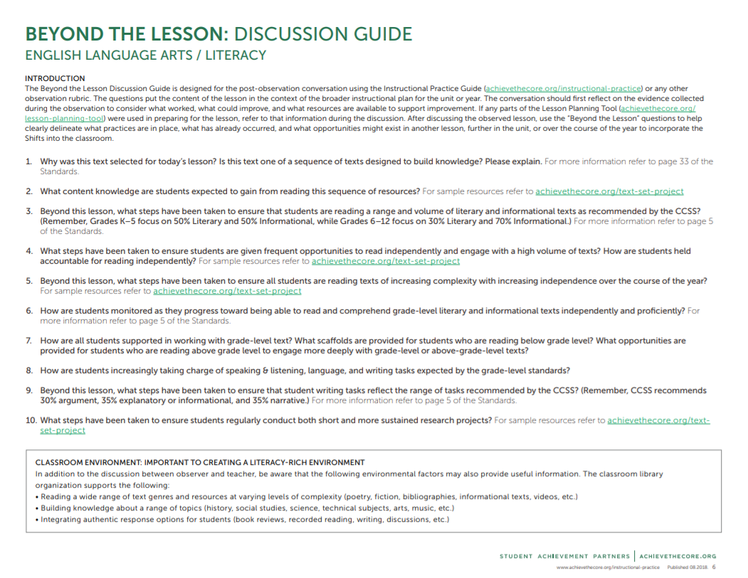
How We Used the IPG
Looking Beyond the Lesson

Slide 38
Questions for Our Guests?

Slide 39
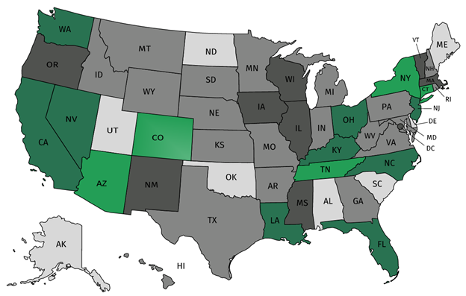




Join Our Network!
Join a national network of educators
Connect with state networks
Be a part of creating new tools and resources in partnership with SAP
Keep up to date on free resources, upcoming SAP webinars/professional learning opportunities, job postings and more!

Slide 40




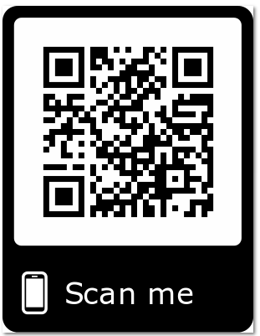
Please Join Us!
https://achievethecore.org/ca-signup
Twitter: twitter.com/achievethecore
Facebook: facebook.com/achievethecore
Pinterest: pinterest.com/achievethecore

Slide 41

Join Our Network!
www.achievethecore.org/ca-signup

Slide 42
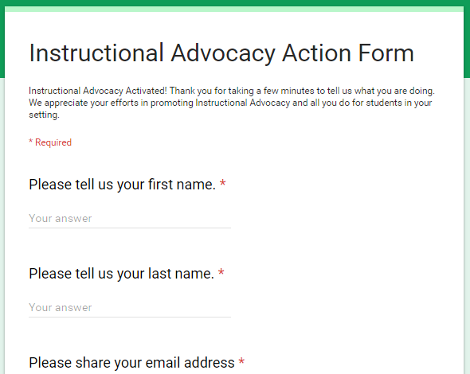
Tell Us About Your Efforts
www.achievethecore.org/educators-taking-action

Slide 43
Please Join Us Again Next Month!
Next month’s webinar:
Math Language Routines –
The What, the Why, the How
November 7th, 7pm ET
This mini-webinar will give a quick overview of the popular Mathematical Language Routines you’ve been hearing about. As in other subjects, math students must be able to read, write, listen, speak, and discuss the subject at hand. Often, these multimodal ways of learning and using math skills are given too little attention in curricular materials, and teachers may want to supplement with classroom activities that provide opportunities for students to use language to discuss the math content they’re learning. Webinar participants will get a quick look at some of the supplementary routines and how to integrate them into grade-level work. These routines benefit ALL students, but a particularly helpful for English Language Learners or those struggling with the linguistic components of math.
Register Here!

Slide 44
Thank You!

